Slide 1

IoT of Smart Learning Factory

Slide 2
Syllabus of IoT Course
Introduction to Smart Factory
Technical Overview of Smart Factory
Introduction to K-Factory
IoT of K-Factory
IoT Practices
IoT Device
8-bit device (Aduino Uno compatible)
IoT Gateway
32-bit device (Raspberry Pi 3 B)
IoT Platform
KT IoT Makers
Practical Team Project
Propose an idea and apply the result to K-Factory
A practical practice is the good way to catch the knowledge & techniques.

Slide 3
Technical Overview of Smart Factory

Slide 4


What’s the Smart Factory ?

Slide 5
What’s the Smart Factory ?
( ??? ) is a broad category of manufacturing that employs computer-integrated manufacturing, high levels of adaptability and rapid design changes, digital information technology, and more flexible technical workforce training.
A ( ??? ) is a highly digitized and connected production facility that relies on smart manufacturing. Thought to be the so-called factory of the future and still in its infancy, the concept of the smart factory is considered an important outcome of the fourth industrial revolution, or Industry 4.0.

Slide 6
What’s the Smart Factory ?
Technical Collaboration for Optimal Manufacturing
SF
PT
ICT
AT
OT
IT
CT
Technical Goal
Business Goal
Hyper-Connectivity
Hyper-Intelligence
High : Productivity, Quality
Low : Cost, Downtime

Slide 7
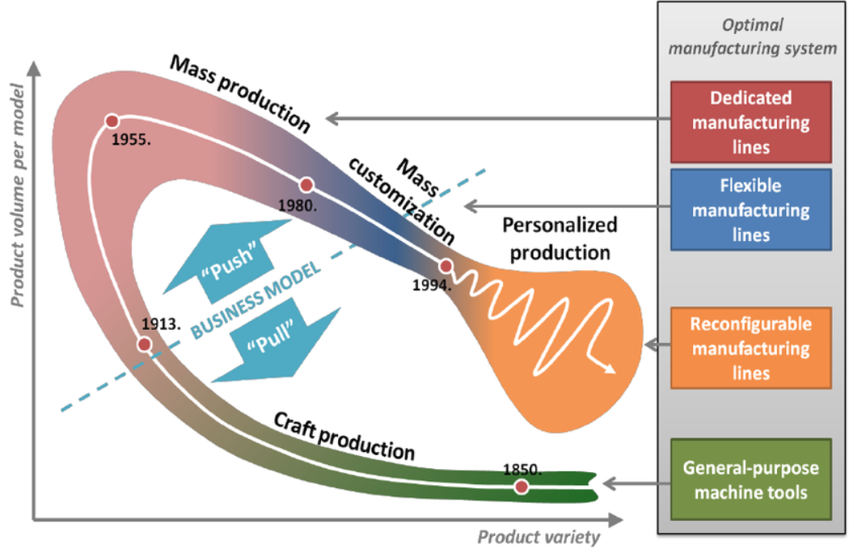
Revolution of Global Manufacturing System
Challenge !
Cost of Personalized Production ≅ Cost of Mass Production

Slide 8
Smart Factory ?
Conventional
Automated Production Line
Smart Factory
Intelligence
+Prediction/Decision
CQO-cycle
Data Mining/Data Warehouse
Analytics
Statistics
Reporting/Logging
Connection
Open Connectivity
IIoT/IE, OPC-UA
Connection
Closed Connectivity
Fieldbus/Internet
Digitalization
Sensing/Monitoring
Embedded System, DT
Machinery
Specialized
Servo
Machinery
Flexibility
Uni-direction
Reconfigurable/Collaborative Robot
Self-Reconfigurable, Self-Repairable
DT : Digital Transformation
CQO : Continuous Quality Optimization
IIoT : Industrial IoT
IE : Industrial Ethernet

Slide 9
Smart Factory vs. Automated Line
Flexibility & Autonomy
Self-reconfigurable
Self-repairable
Self-adjustable
Open control loop vs. Closed control loop
Feedback system with intelligence
Wide coverage of supervisory control
Remote monitoring
Intelligence for decision making
Data warehouse

Slide 10
View of Product Lifecycle
Uni-directional vs. Bi-directional communication channel/Interaction in product lifecycle
As-is
Uni-directional flow of control, report-based
To-be
Bi-directional flow of control, transaction-based
Report
Report
Customer
Factory
Logistics
Uni-directional
Report
Transaction
Transaction
Customer
Factory
Logistics
Bi-directional
Transaction

Slide 11
View of Control Aspects
Open-control vs. Closed-control Loop
As-is
No autonomous feedback, just logging
To-be
Autonomous reacting based on the result of analytics
Asset
Controller
Logging
Asset
Controller
& Sensor
Logging
Analytics
Reacting

Slide 12
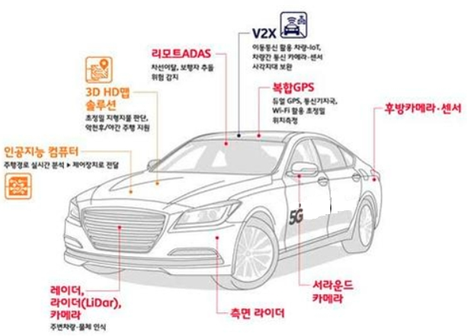

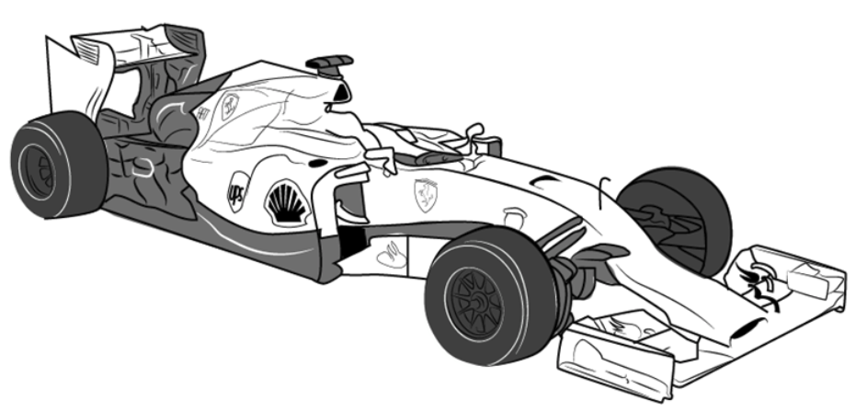
Smart Factory ?
Conventional
Automated Production Line
Smart Factory
Fully automated machine driven by human expert
Self-configurable autonomous machine driven by artificial intelligence

Slide 13
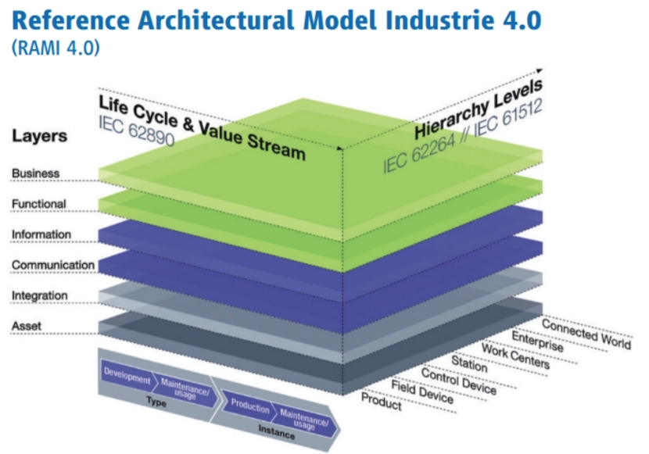
Reference Model for Smart Factory
Structure Layers
Manufacturing Layers
Production Layers

Slide 14
Key Technologies of Smart Factory
Key technologies of IT supporting successful smart factory → ICBM
IoT
Connectivity, Realtime, fast response(low delay), secure data storage.
Cloud
Private, public
PaaS(platform), SaaS(framework)
Big Data
Data analytics
Storage (distributed)
Data access control
Data warehouse
Machine Learning
Stochastic process control
Predictive maintenance
Fault prediction

Slide 15
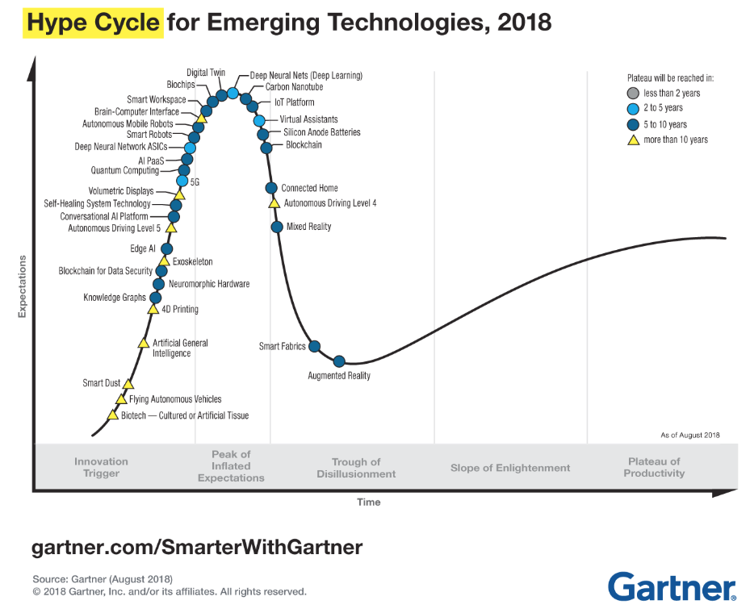
Gartner’s Hype Cycle

Slide 16
Competency Model of “Industrie 4.0” Employees
Competency Dimensions |  | Information Systems (IS) | Computer Science | Engineering
Analyzing and Interpreting | Writing and Reporting | ·Targeted/Technical Communication ·Literacy
 | Applying Expertise and Technology | ·IT and Technology Affinity ·Economics ·Extract Business Value from Social Media
 |  | ·Service Orientation/ Product Service Offerings ·Business Process Management ·Business Change Management ·Understand and Coordinate Workflows | · Network Security · IT Architectures · Machine Learning
 |  |  | ·System Development ·Integrating Heterogeneous Technologies ·Mobile Technologies ·Sensors/Embedded Systems ·Network Technology /M2M Communication ·Robotics/Artificial Intelligence ·Predictive Maintenance
 |  | ·Modelling and Programming ·Big Data/Data Analysis and Interpretation ·Cloud Computing /Architectures ·In-Memory DBs ·Statistics ·Data Security
 | Analyzing | ·Problem Solving ·Optimization ·Analytical Skills ·Cognitive Ability

Slide 17
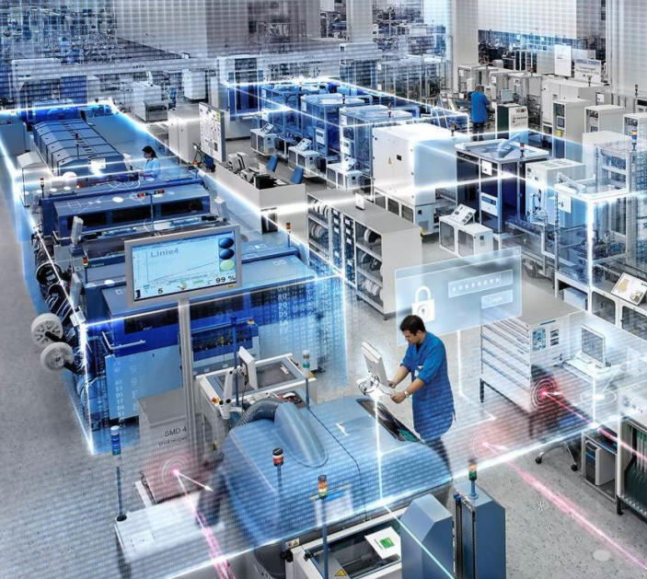
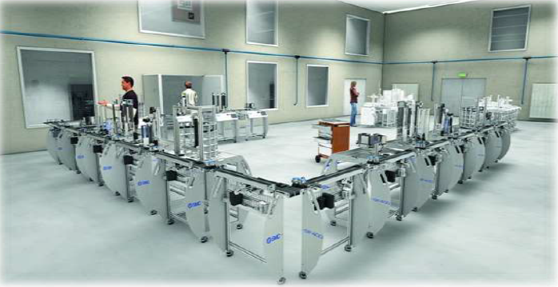
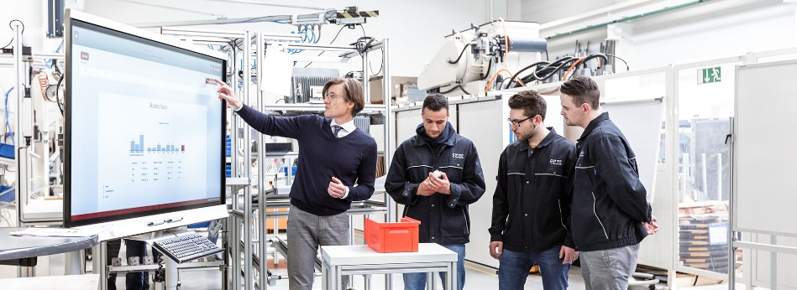
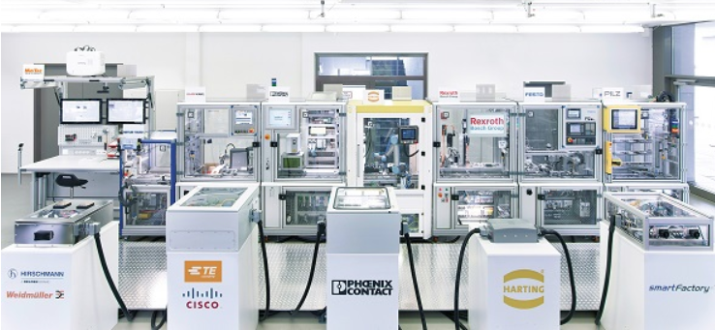
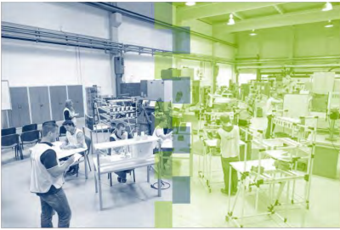
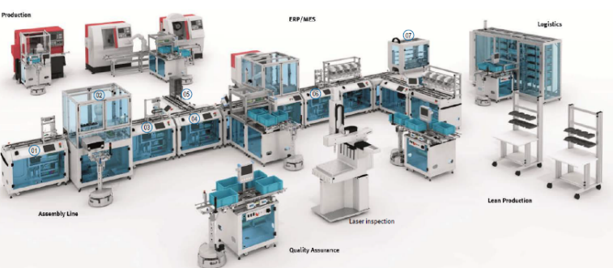
Reference Sites of Smart Factory (Oversea)
Siemens Amberg
SMC’s training system for Industry 4.0
Tech. Univ. Darmstadt
SMC
Univ. of Ruhr, Bochum
SmartFactoryKL @DFKL Kaiserslautern
FESTO

Slide 18
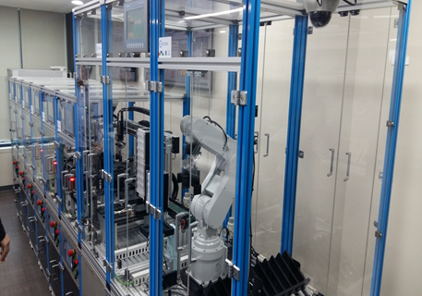
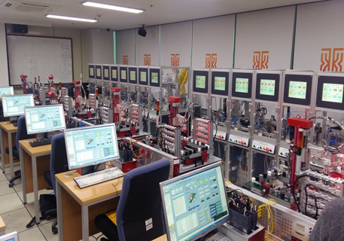
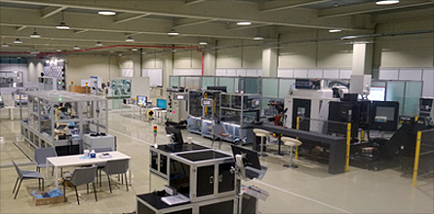
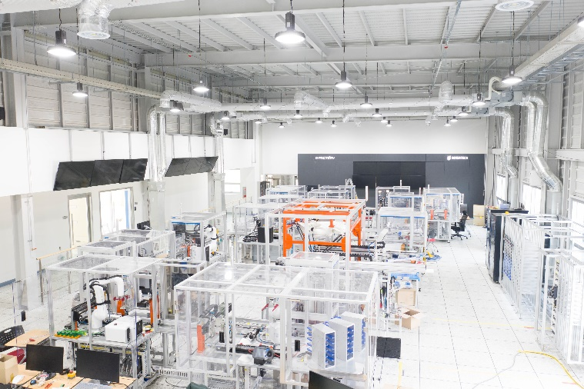
Reference Sites of Smart Factory (Domestic)
Korea Polytechnics.
KoreaTech’ 2nd Campus
Smart Manufacturing Innovation Center in Ansan
KoreaTech’s K-Factory

Slide 19
Introduction to K-Factory

Slide 20
K-Factory ?
KoreaTech’s maker space for smart factory
Smart Learning Factory (SLF)
POC
- Rapid-prototyping
- Mock-up
Engineering
Sample
Mass
Production
Idea
In Service
Learning Factory
(Dadam)
Smart Factory
(K-Factory)

Slide 21
Roles of K-Factory
A POC (Proof Of Concept) line of SF technologies.
A test-bed and maker-space for solution provider of SF, including companies.
A test-bed for research engineers
Practice/research facilities for undergraduate/graduate students.
A open SF platform for small/medium-scale companies.
A show-case for envisioning SF technology as edge technology to students.

Slide 22
Features of K-Factory
Resilient
Stopless production line
Self-recoverable
Reconfigurable
Easy change of production line for personalized production.
Hot-swapping
Reliable
Fault-tolerant : smooth swapping between active and standby station.
Load balancing between multiple stations.
Resizable
Scalable to production targets.
R4U (Revolutions for You !!)
Resilient
Reconfigurable
Resizable
Reliable

Slide 23

Horizontal View of K-Factory
Product view
End-2-End personalized production
Feedback
Order
Personalized Order System
MES
Control Server
Manufacturing Line
Logistics
Delivery

Slide 24



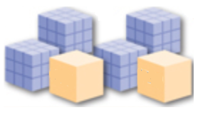
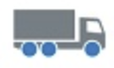
Configuration of K-Factory
ERP
Personalized Order
PLM
MES
SCM
Customer
SCADA
Data
Warehouse
FMS
Logistics
Warehouse

Slide 25
Vertical View of K-Factory
Company view
4M (Man, Machine, Material, Method)
ERP (Enterprise Resource Planning)
Integrated management of main business processes
ERP
CRM
PLM
SCM
SCM (Supply Chain Management)
Management of the flow of goods and services
PLM (Product Lifecycle Management)
Managing the entire lifecycle of a product.
MES
CRM (Customer Relationship Management)
Managing a company’s interaction with current & potential customers.
Operational Server
Manufacturing Assets
MES (Manufacturing Execution System)
Tracking the transformation of raw materials to finished goods.

Slide 26
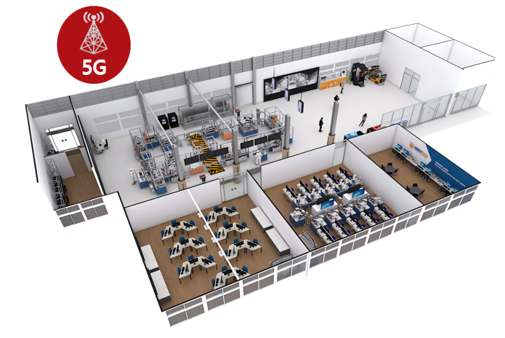
Statistics of K-Factory
17 Task stations.
2 User stations.
2 Warehouses.
3 types of PLC (Siemens, Mitsubishi, Omron).
53 Servo’s.
9 Robots (Industrial, Collaborative, Delta).
2 AMR’s.
6 Shuttles on Montrac.
4 Sensors on realtime monitoring system.
1 Base station for 5G connection.
4 POP’s.
1 DID.
Key Features
* Personalized production
* 5G-based connected factory

Slide 27

Personalized Production
Parameterized Design Assist System
Taste Analysis
Order
Design Assist
Manufacturing Execution
Product Templates
Tools
Personalized Taste Profile
Design Editor
3D Mechanical Model
Functional Model
Cost Evaluation
Manufacturing-Capability Check
Quality Pre-estimation

Slide 28
Personalized Production
Mass production(MP) for cost-down
Personalized production(PP) for increasing customer’s satisfaction.
PP results in increasing manufacturing cost(MC).
To down the MC of PP, Increase automation-level of production facilities, a.k.a Factory Automation.
FA reaches the limit of sustainable cost-down.
ICT will break such limit.
By utilizing ICT to PP, we can procure the sustainability of cost-reduction.

Slide 29


Personalized Production in K-Factory
Order Processing Flow
Operator
Order
Production
Task Issue
Order
Order
Order Scan
MES
Task Execute
Customer
Order App
Order Service Server
Process
Control
Server
Stations
Reply
Order Fetch
Data Warehouse Server

Slide 30

5G-based K-Factory
Connected Factory
5G Connection between physical factory and virtual factory
virtual factory in digital-twin : realtime interworking.
F-1
F-2
F-3
F-1
F-2
F-3
Factory-1
HQ
Expectations
?
F-1
F-2
F-3
F-1
F-2
F-3
Broad Bandwidth
High Speed
Low Net Delay
Seamless Connectivity
High QoS
Factory-2
Offices
F-1
F-2
F-3
F-1
F-2
F-3
Factory-3
R&D Lab.
F-n
Physical Factory
F-n
Virtual Factory

Slide 31

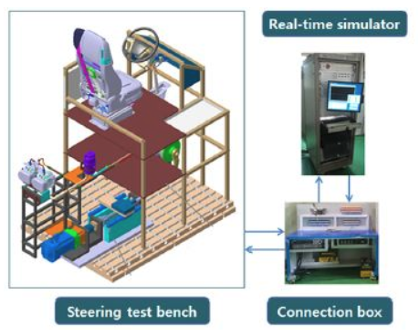
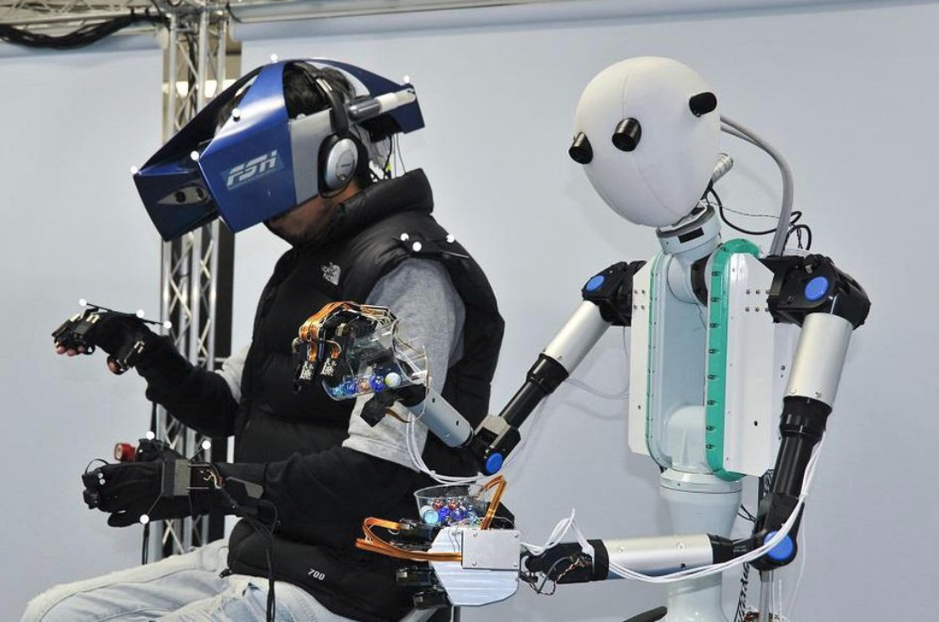
5G-based K-Factory
Emerging technologies for connected factory
Tele-presence Technique
HILS(Hardware In the Loop Simulation)
Tele-operating System

Slide 32
Curriculum of K-Factory
Field | Level Key Tech. | Fundamental | Professional | Expert | Master
FMS | PLC | PLC Basic | PLC & Servo Control | PLC Network | Smart Process Design
 | Robot | Robot Engineering Practice | Robot Control & Simulation | Intelligent Robot
 | Sensor, Actuator, Control | Sensor Overview | Sensor & Actuator | Measurement & Control
 | Vision | Image Processing | Computer Vision & Application Practice | Computer Vision Application
 | 3D printing | 3D Modeling | 3D Product Design Practice | 3D Printing Application
 | CPS | CPS Overview | Virtual Factory Simulation Practice | Process Optimization using CPS | CPS Design of Smart Process
 | Process Design | FA & Smart Factory | Process Control of SF | Process Optimization
 | Manufacturing Management. | Understanding of Production Quality Management | Theory of Production Quality Management | Enterprise Resource Management
ICT | IoT | IoT Overview | IoT Network, Sensor/Actuator Control | IoT Application & Security | IoT System Design
 | Big Data | Big Data Overview | Big Data Collection/Storage | Big Data Analysis & Visualization | Bit Data based Process Optimization
 | AI | Machine Learning Overview | Deep Learning Theory & Practice | Machine Learning Application
 | Cloud | Intro. To Cloud | Cloud Platform Practice | Cloud Service Application
 | AR/VR | Graphics Overview | AR/VR Programming | Vision-based AR/VR Application | AR/VR based Process Management
 | Security | Information Security Overview | System & Network Security | Intrusion Detection and Response

Slide 33
IoT of K-Factory

Slide 34
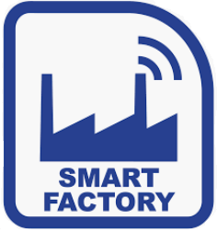
IoT Services of K-Factory
Collection
Realtime data collection
Storing
Distributed secure data storage
Analyzing
Statistical analysis, Data mining
Visualizing
Textual/Graphical, AR/VR/Hologram
In-service
IoT platform/framework services for medium/small-scale companies.
Technical consulting
FEEDBACK
DATA
Collecting
Storing
Analyzing
Visualizing
In-service

Slide 35
Realtime Data Collection of K-Factory
Real-time Monitoring System (RMS)
Less than 1ms ( > 1000 SPS)
More than 1K tags
Monitoring types
logging, reporting, alarming, sensing
Monitoring Data Types
Byte stream
Video stream

Slide 36
Services of RMS
Autonomous personalized production
Stochastic process control
Predictive maintenance
Self-reconfiguration of production line
Enhancement & optimization of production line
Connected factory : digital twin
AR/VR for workers : Air manual, AR-based mentoring system
AR/VR-based education/training tools
Big data portal for public access

Slide 37
Monitoring Targets of RMS
Servo motors
Siemens PLC
Omron PLC
Mitsubishi PLC
Robots
Collaborative robots
Industrial robots
Delta robots
IoT devices
Temperature
Vibration
Lifetime of device
AMR(Autonomous Mobile Robot)

Slide 38



Real-time Monitoring System
Edge Server
Public/Private Cloud
Sensing Channel
Field
Bus
Asset
PLC
OPC-UA
Server
OPC-UA
HTTPS/MQTT
PLC
PLC
Asset
IoT Device
IP
Reference Models
MS’s Azure
SIEMENS’s MindSphere
KT’s IoT Makers
Asset
PC-Based
IP
Asset
Mobile-Based
IP
Edge Computing
Cloud Computing
High Speed(Realtime),
Raw Data
Low Speed(Non-Realtime),
Pre-processed
Sensing Channel : GPIO, Serial, WiFi, BT

Slide 39
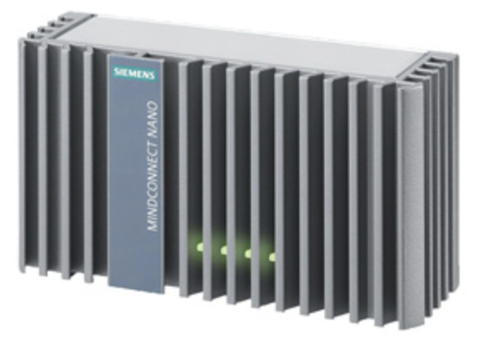
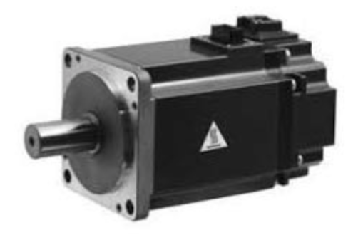
Realtime Monitoring Configuration - Servo
A-Zone : Siemens PLC * 9
B-Zone : Mitsubishi PLC * 5 + Omron PLC *3
PLC
(O, M)
OPC-UA
Server
MindConnect
Nano
PLC
(S)
Position
MindSphere
Servo
Servo parameters : Position, Torque(current), Speed
Connection test
Monitoring

Slide 40
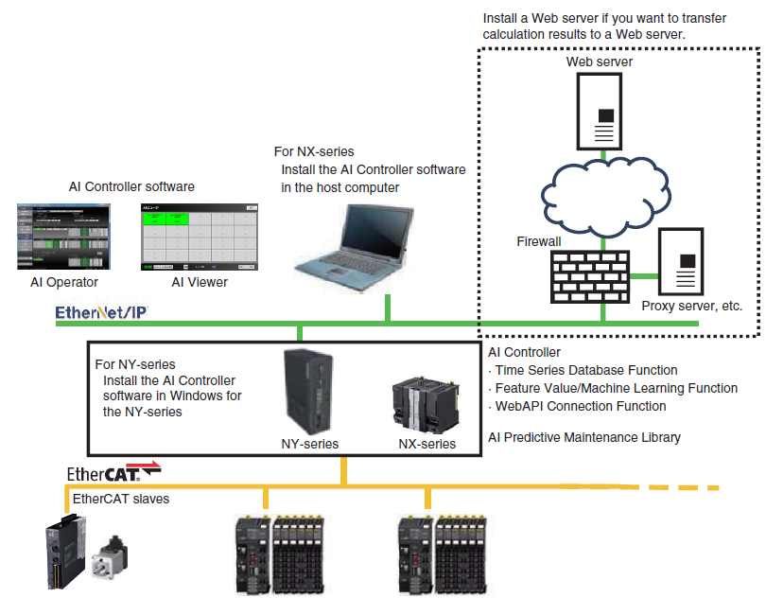
Commercial RMS
OMRON AI Controller
Cycle time : 125us
AI Operator
AI Viewer
AI Modeler

Slide 41
Why Cloud ?
Saving the cost of computing infrastructure by hardware virtualization
IaaS(Infra as a Service)
Saving the cost of operating & maintenance by sharing computing resources, by improving accessibility & connectivity to them.
PaaS(Platform as a Service)
Free to make IT services secure and protect personal information.
No need to hire IT experts to handle IT services.

Slide 42
Public Cloud Services
SF platform
Siemens Mindsphere
GE Predix
IoT platform
KT IoT Makers
Generic platform
Microsoft Azure
Amazon Web Service (AWS)
Google Cloud Platform (GCP)
Oracle Cloud Infra (OCI)
IBM Bluemix
OpenStack (free)

Slide 43
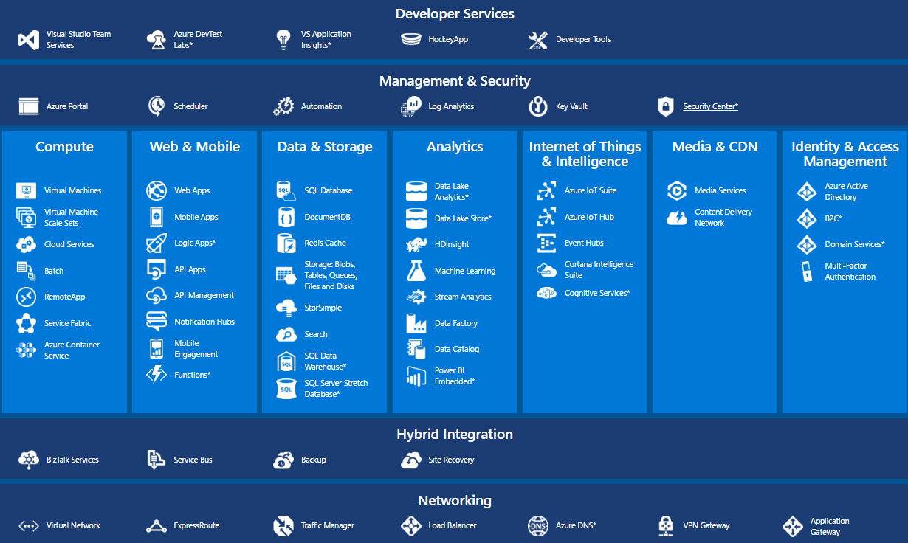
Cloud Platform – I : MS’s Azure
Pay-as-you-go

Slide 44
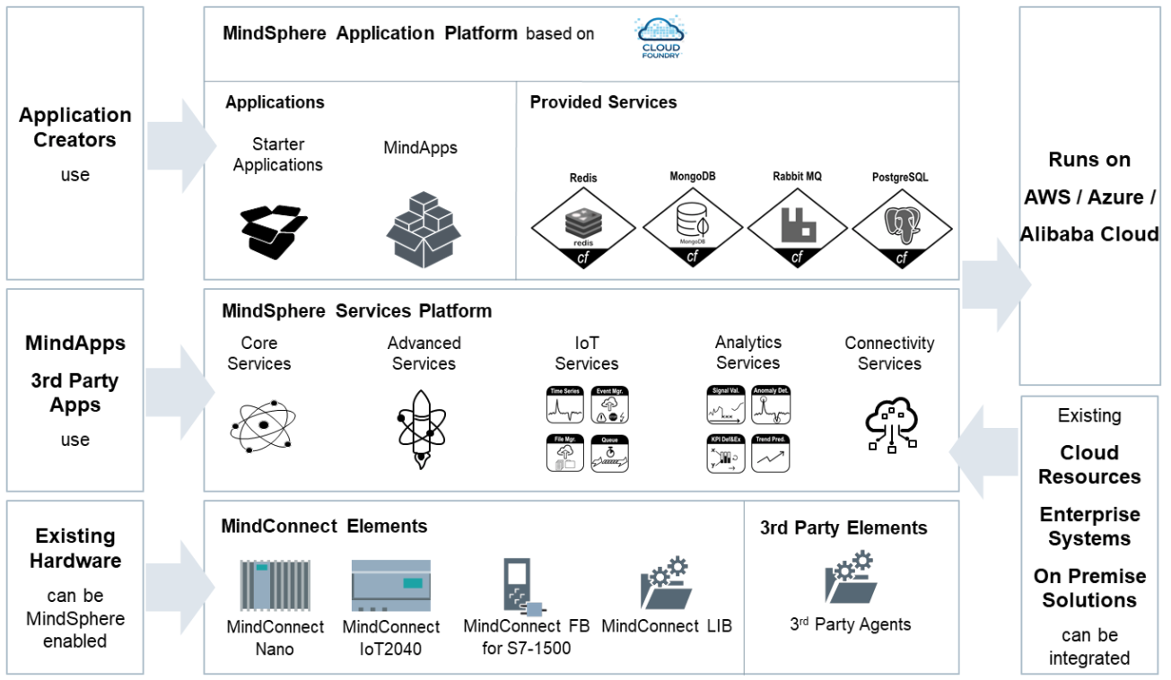
Cloud Platform – II : SIEMENS’s MindSphere

Slide 45
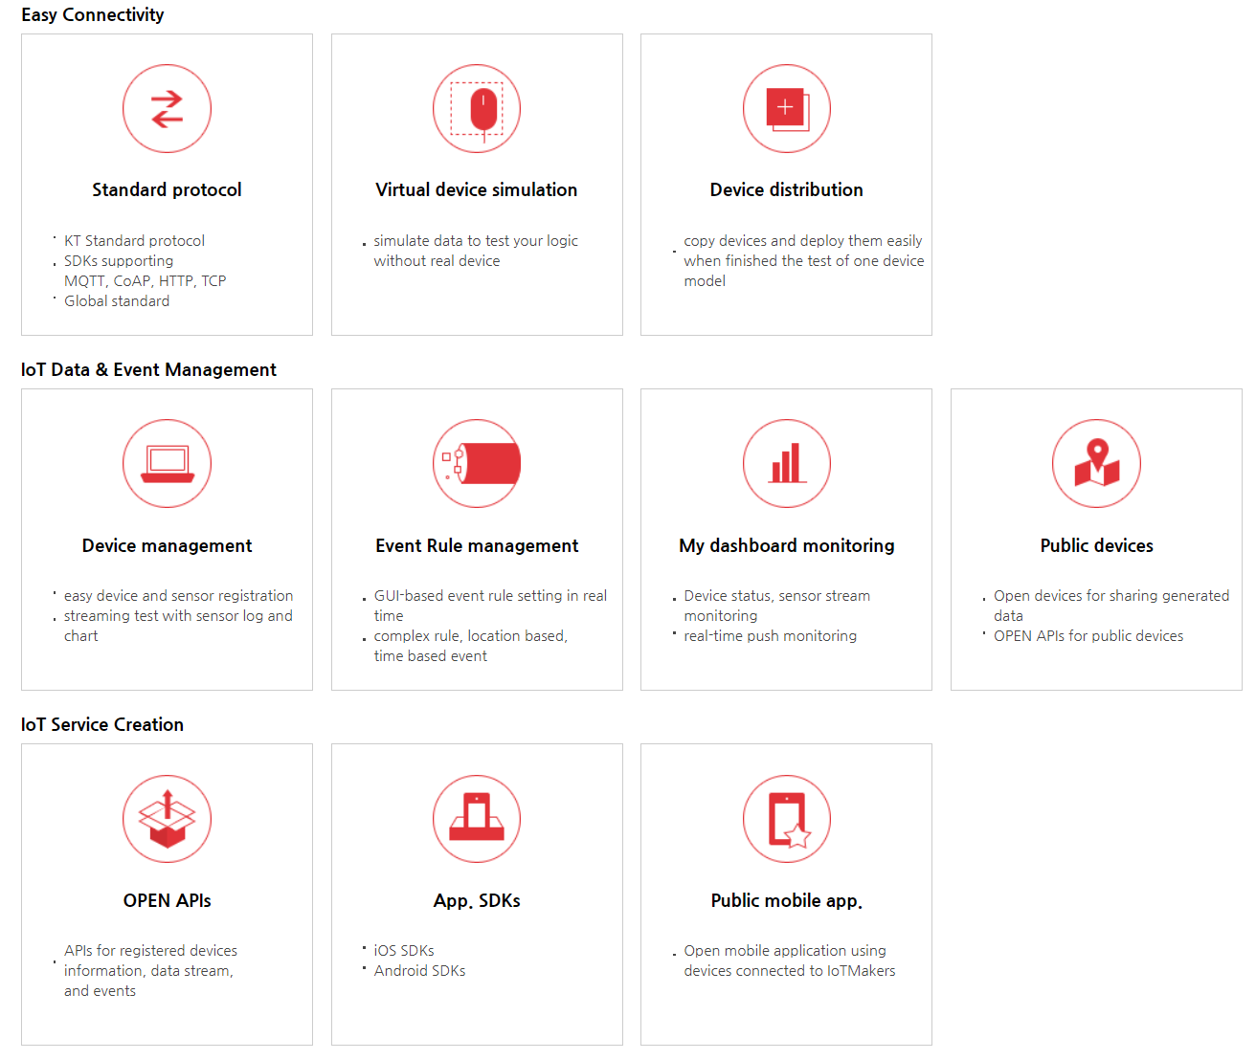
IoT Platform – I : KT IoT Makers

Slide 46
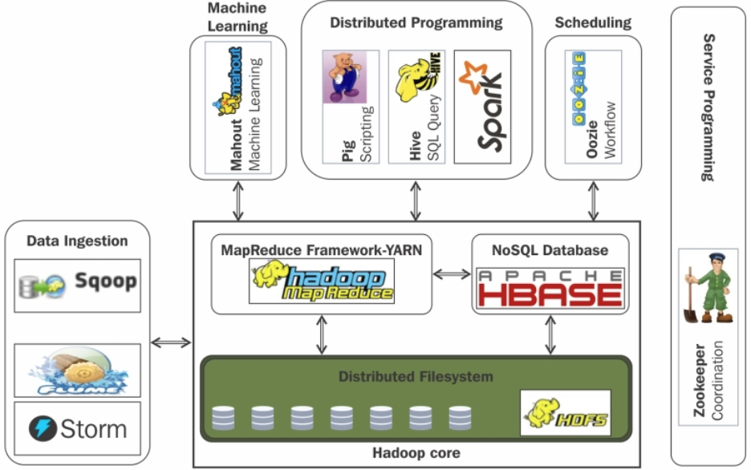
Reference Model for SLF Framework
Hadoop

Slide 47
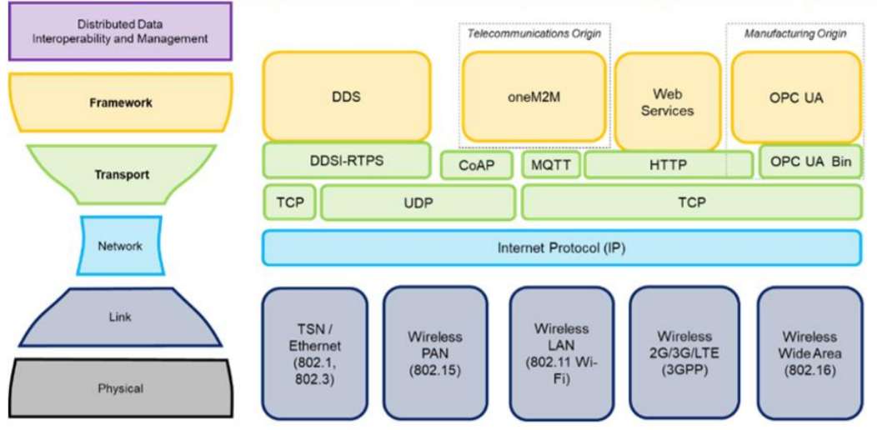
IIoT Connectivity Framework

Slide 48
Break !

